Slide 1

Azure for “Normal” People
Arrange yourselves into four co-operative working groups (3 groups of 4 learners)
In your groups, write a list of all the “Azure Words” you know
Teresa Binks
Stephen Brown
Tom Prutz
Notes:
Welcome to Azure for Normal People
We're delighted to know we have this many normal people in the department!

Slide 2
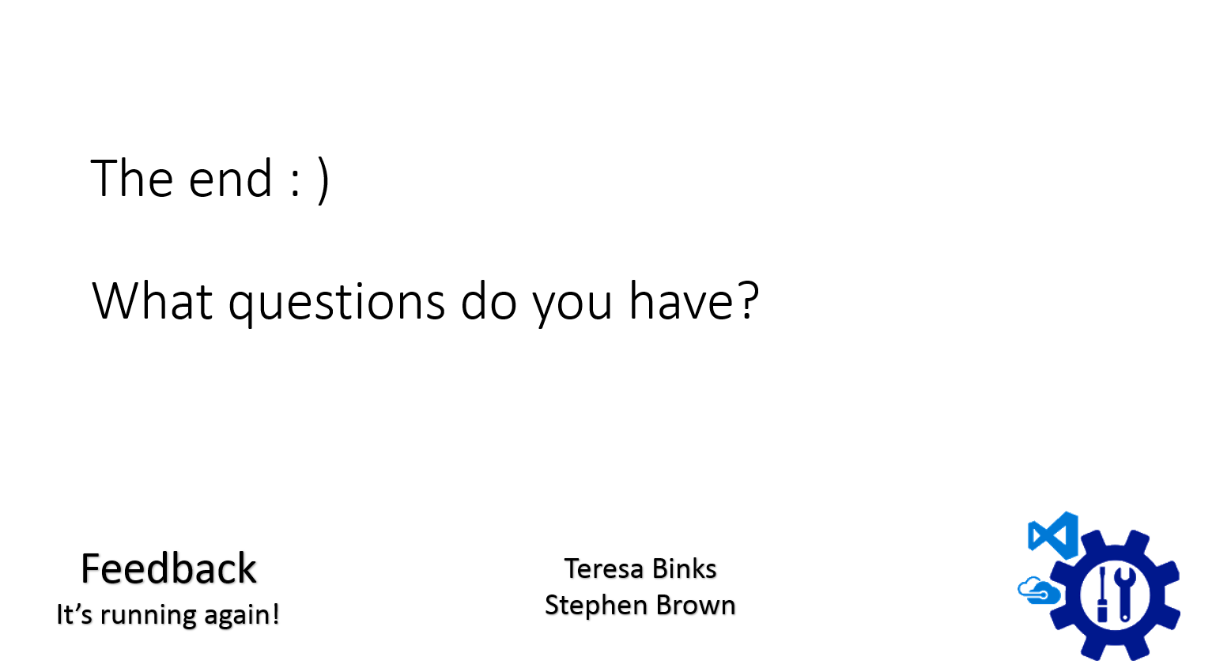
What it’s about
What it’s not about
Build-a-Cloud
So what?
Notes:
I've given you a sneak preview of my last slide. We have run this twice already and had some great feedback which has helped us adopt and change bits to make the example work better. We'll be sending out a feedback request later today and your feedback is vital to improving the training and helping us tailor future sessions.
I'm going to establish what this session will be about, and what it'll deliberately not be about.
We're going to get hands-on with building a physical representation of what we deploy to the cloud, and we're going to touch on how the organisation is set up for cloud-y things. The example we use is somewhat contrived however we ask you to go along with it to help foster a learning environment.
So, let’s get started...

Slide 3
Change
repeatability
supportability
extensibility
accessibility
- self service
DevOps
Whole Life Support
maturity
elevate state
Principles
Recoverability not Reliability
Cloud
Vs
On-Prem
Azure
Scaling and Performance
Notes:
There has been a lot of change introduced to the organisation in the last couple of years. Our ongoing transition to Azure is one of those changes. But there are several other factors that have been piggy-backed on to that change. I want to spend a moment calling some of them out explicitly so that we can share a common focus of this session.
The move to Cloud vs On-Prem has been a big shift, though we've had teams like Engagement services working into the Amazon Cloud (Amazon Web Services) for quite some time before we more widely adopted Azure. Engineering in the Cloud has different areas of focus and ways of doing things: Engineering for recovery rather than reliability is a big one, as well as handling performance and scaling differently.
We've also attempted to restructure the department for "Whole Life Support". That also changes they way we engineer.
The move to the Cloud and the desire for Whole Life Support has accelerated our DevOps adoption. DevOps means different things to different people. To me, it means bringing some of the hard-won engineering discipline around the -ilities - repeatability, supportability, extensibility - to the Operations line of work. One of the ways we do this is by automating the provisioning of supporting infrastructure, and making it self service. This automation and self-service approach empowers our engineers to do much more for themselves within team, which lets them go faster. They don't have to wait in a queue for stuff to be done for them; they can just get on with it.
For those of you who have had the brief of IAAS, PAAS, SAAS, this is where it really comes into play. The higher up this stack a solution is architected, the more empowered developers are to get on with stuff, and the less reliant they are on operations resource.
With all this change going on, some of us have used the unsettled period to push an a agenda of engineering principles. Engineering for the cloud does require different handling, and several of the tech leads, and Engineering Practice, and Common Engineering as a part of that, have shoved our oars in to try to elevate the state of our practice whilst we're all having to learn new anyway. We might as well learn the new in the right way, rather than having to relearn the right way later.
We've also introduced Azure. But it's worth noting that all these sources of change are interrelated with, but not dependant upon, our Azure adoption. We could have self-served our on prem infrastructure (it would have been much more difficult). We could have encouraged our teams to become DevOps teams (there wouldn't have been much point).
So, these are all the things we aren't going to talk about. If you would like to talk about them more, let us know. If we get demand, then we'll go into them more in another session.

Slide 4

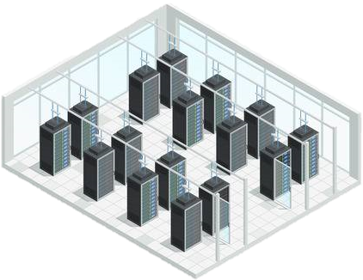
The Cloud
Notes:
So, the Cloud. This is the world. All over the world there are data centers owned by Microsoft. All of those servers work together to run software hides all that complexity in order to look like....

Slide 5
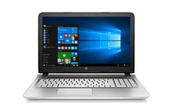
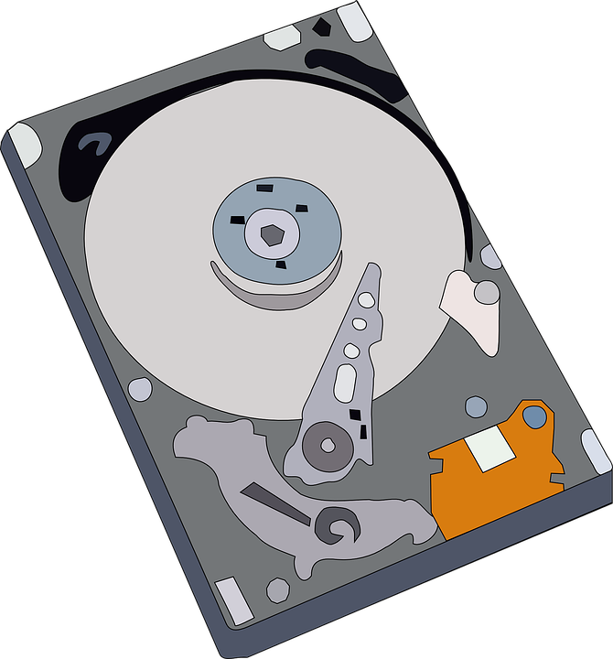
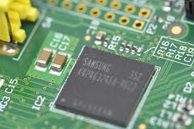



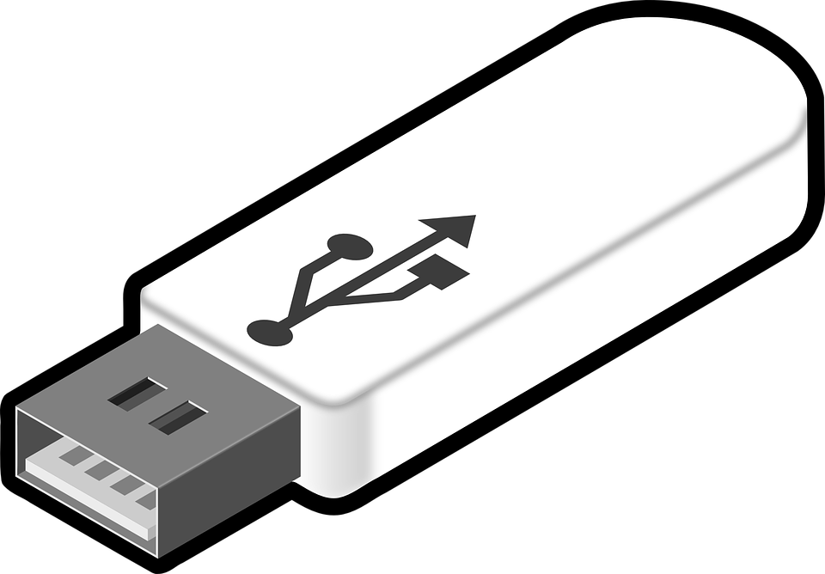
Notes:
A single computer.
I think of Azure (or Amazon, or Oracle Cloud, any Public Cloud) as a big computer, and I think of computers having three main bits. The the storage bits, the processing bits (the thinking bits), and the things that carry messages between thinking bits and storage bits (or between thinking bits and thinking bits, storage bits and storage bits)

Slide 6
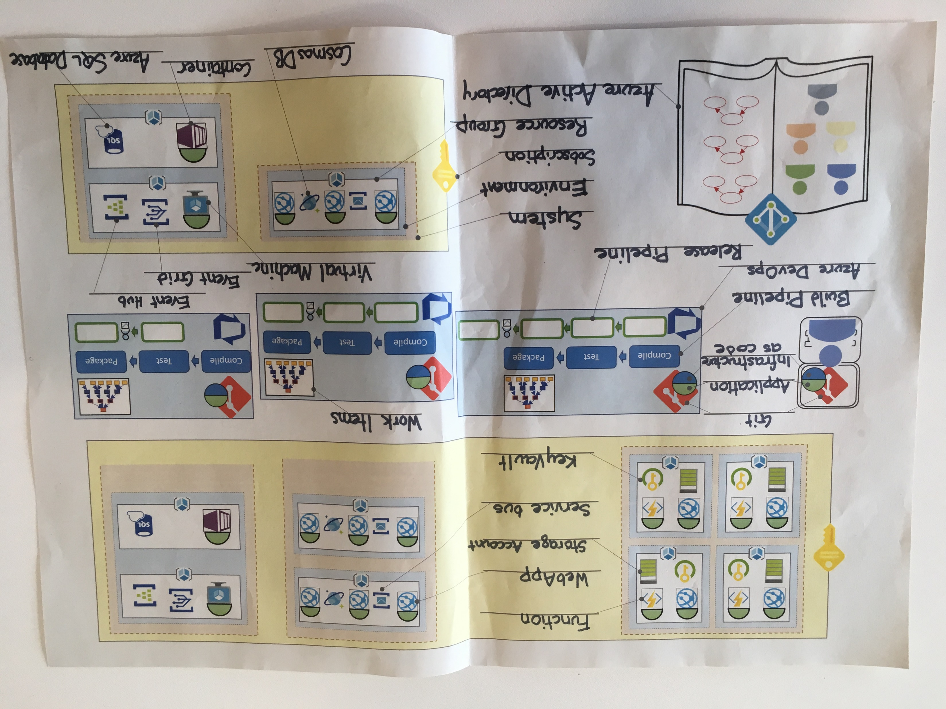

Slide 7
OMG we sold something!
As a
Local Authority
I want
a list of Residential Buildings in an area
So That
I can use that data to make plans
Notes:
So, how do we introduce all these bits of Azure?
Well, happily, we've got a customer that wants a product! We've won a bid! We're going to build a system in Azure that will create that product.
I will warn you that this is a bit of a contrived example: some of the details aren't wholly accurate, and some things would happen in a different order. Take it for the training exercise that it is.

Slide 8
Geographic area in
List of residential buildings out
Interaction and Display on a webpage
Notes:
The customer requires a service, that:
Given a geographical area, will return a list of buildings that are classified as residential.

Slide 9

☑ Approvals
☑ Business Case
☑ Management Sign off
☑ Budget
☑ Sufficient Coffee
☑ Cost Codes
☑ Investment Requests
☑ Training Requirements
☑ Developer Cake
☑ Development Space
☑ Architecture Review Board
Alex
Name your developer - Place your laptop
Notes:
We've got all the approvals, budgets, costs codes, investment requests, ARB, everything we need to get started. We've even got a developer to start work.
At the moment, your developer can start working on their laptop.

Slide 10
Developer
Laptop
Application
Application
Application
Place application on laptop
Notes:
They are going to start writing their application. They're going to run everything on their laptop, not in the cloud, just to prove that they can do stuff. To start off with, they're just going to make a webpage to display the data, and not hook it up to anything real yet.

Slide 11

Developer
Laptop
Application
Version Control
Experimental changes.
Need to spike.
Need to safely trash changes.
Version Control (Git)
Place application on Git on laptop
Notes:
As they are making lots of little changes, and exploring lots of things that may or may not work, they're going to keep breaking stuff.
Let's introduce something that keeps versions of their code so that they can roll back if they break something.
We call this source control. We use git as our source control. It runs on their laptop.

Slide 12

Developer
Laptop
Application
Version Control
Subscription
Need to deploy to Azure
Subscription
Add subscription – Name it a breakfast food
Notes:
When we start in Azure, we start with a Subscription.
Subscriptions are big buckets.
The way OS is set up at the moment, almost all our project work is split over 3 subscriptions, Dev, Test, and Prod.
These are just names. These are just buckets.
We could have chosen to have a Subscription per System. They are really just names for buckets and how we divide resources between them is largely arbitrary.

Slide 13

Developer
Laptop
Application
Version Control
Subscription
ARM
Need Authorisation
Azure Resource Manager
The ARM
Notes:
Subscriptions exist in Azure, in the big bad cloudy world. We need to make sure that we can get to it, and nobody else can. We do this with Azure Active Directory. Azure Active Directory is like a book of users, sometimes arranged into groups, and any permissions we give to users are recorded in the Active Directory. We're going to give our Developer permission to create things in our subscription. Do this now, like this.

Slide 14

Developer
Laptop
Application
Version Control
Subscription
ARM
Need Authorisation
… has the role of…
… on the resource called…
Alex
Contributor
eggs
Role Based Access Control
RBAC
in the
Azure Resource Manager
The ARM
Give your developer access to your subscription via the ARM
Notes:
Subscriptions exist in Azure, in the big bad cloudy world. We need to make sure that we can get to it, and nobody else can. We do this with Azure Active Directory. Azure Active Directory is like a book of users, sometimes arranged into groups, and any permissions we give to users are recorded in the Active Directory. We're going to give our Developer permission to create things in our subscription. Do this now, like this.

Slide 15
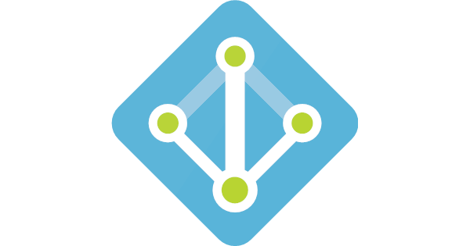
Developer
Laptop
Application
Version Control
Subscription
ARM
Need “Who”
Need Authentication
Azure Active Directory
Notes:
Subscriptions exist in Azure, in the big bad cloudy world. We need to make sure that we can get to it, and nobody else can. We do this with Azure Active Directory. Azure Active Directory is like a book of users, sometimes arranged into groups, and any permissions we give to users are recorded in the Active Directory. We're going to give our Developer permission to create things in our subscription. Do this now, like this.

Slide 16
Users
Alex
Azure Active Directory
Groups
Group Name:
Users:
Group Name:
Users:
Add your developer to AAD

Slide 17








Slide 18

Developer
Laptop
Application
Version Control
Subscription
ARM
AAD
Resource Group
Need to deploy to Azure
Resource Group
Add Resource Group to Subscription
Notes:
Resource Groups exist in a subscription. Resources are grouped together into Resource Groups. Resource Groups are logical containers.
They don't cost anything. Resource Groups are intended to lump together the things that change together.
They make it easy to remove everything that makes a discrete thing, but removing the Resource Group it is contained in.
So we have a subscription, a resource group, and access to them via Active Directory.

Slide 19


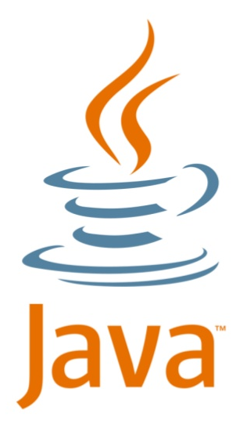
Developer
Laptop
Application
Version Control
Subscription
AAD – user and permission
Resource Group
Execution Environments
Application
WebApp
Add WebApp to Resource Group – run a copy of the application on it
Notes:
Our developer has written some bare bones application code. And it's running on their laptop.
Application code needs to sit in something that'll run it.
At this point, the software on the laptop is the execution environment.
But it could be a server in the data centre, or a computer running linux rather than windows. Or on a language specific runtime like the Java JVM. But for us, we want it in Azure, so we're going to create something to be the execution environment in Azure.
We're going to create a WebApp. This is an execution environment that is ideal for serving up webpages, and can easily be talked to via REST, which is like sending data by visiting urls.
So, let's get a WebApp and put it into our Resource Group in our Subscription in Azure. And then let's push our application code to it. (little application codes)
Horay! We have a webpage that we can access. Our application code is running in a WebApp, that is contained in a Resource Group, that exists in a Subscription, in Azure, and secured by Azure Active Directory.

Slide 20
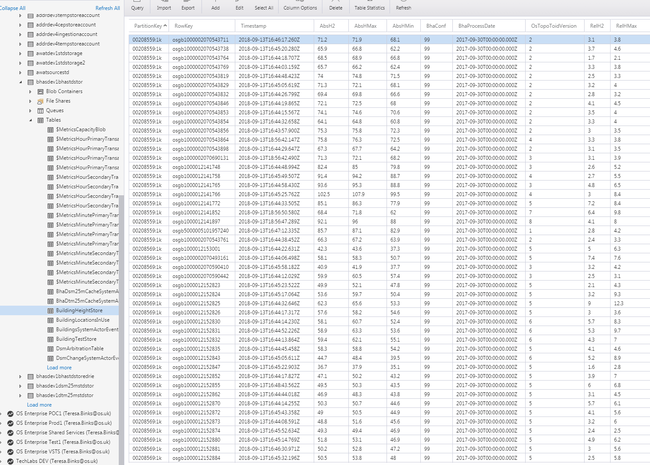
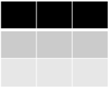
Developer
Laptop
Application
Version Control
Subscription
AAD – user and permission
Resource Group
WebApp + Application
Table Storage+ Storage Account
Need real data
Table
Table Storage
Notes:
Next, we want to start providing some real data for the webpage to deploy. We're going to need some storage.
Let's use the Table Storage offering. Tables are lightweight, responsive, fast storage options. Almost all of Height uses table storage exclusively. Table storage looks a spreadsheet.

Slide 21
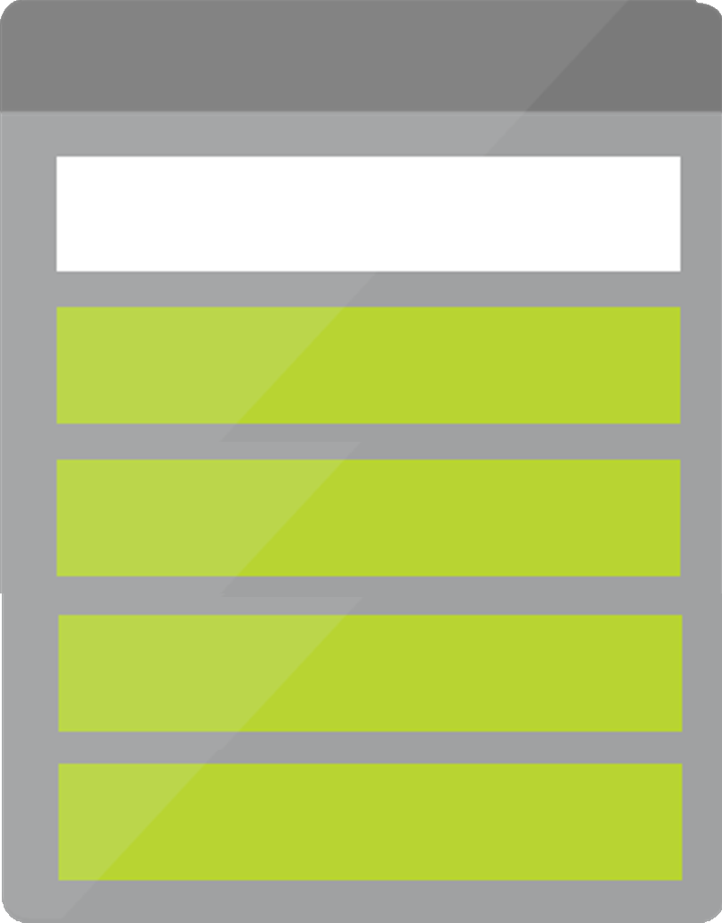
Developer
Laptop
Application
Version Control
Subscription
AAD – user and permission
Resource Group
WebApp + Application
Table Storage+ Storage Account
Need real data
Storage Account
Table
Storage Account >
Table Storage
Add Storage account to Resource Group – label the fact we’re using table storage
Notes:
Table Storage is one part of a Resource called a Storage Account. Go grab a Storage Account to store our data, and a Table Storage icon to show that's the bit we're using.

Slide 22
Developer
Laptop
Application
Version Control
Subscription
AAD – user and permission
Resource Group
WebApp + Application
Table Storage+ Storage Account
Connection String
Need to connect
Storage Account
// stg1ad4g7
Table
Notes:
The Storage Account has a URL, like a website address, that things can use to connect to it. It's called a connection string; it's just like a postal address. We need some way of telling our application code what that connection string is.
But that connection string is sensitive information. We shouldn't just code it in to our application - that's not secure.

Slide 23
Developer
Laptop
Application
Version Control
Subscription
AAD – user and permission
Resource Group
WebApp + Application
Table Storage+ Storage Account
Connection String
Need to connect
Storage Account
// stg1ad4g7
Table
Notes:
We need a way of storing that connection string securely, so that our application can get it.

Slide 24

Developer
Laptop
Application
Version Control
Subscription
AAD – user and permission
Resource Group
WebApp + Application
Table Storage+ Storage Account
Need to connect
securely
Storage Account
// stg1ad4g7
// stg1ad4g7
Table
Key Vault
Add KeyVault – put Storage Account’s connection string in KeyVault
Notes:
We'll use a Key Vault. Key Vaults are a secure storage mechanism that lets us store secrets that have names. We'll store our connection string in the Key Vault. Our WebApp can securely access the Key Vault to get the connection string - let's not go into how in this session!

Slide 25


Slide 26
They want more
As a
Local Authority
I want
a list of heighted Residential Buildings in an area
So That
I can use that data to make plans
Notes:
Our users are thrilled, and they've commissioned us to make an improvement.

Slide 27
Query the building heights data source
For every building
Simple Application
+ Execution Environment
This feels like a lot of work – we need more developers!
Notes:
Now our service needs to:
Given a geographical area, return a list of building heights, for buildings that are classified as residential.
This is a bigger problem. We're going to have to get some more developers involved.

Slide 28

Roby
Name your new Developer – give them access to the subscription in AAD
Notes:
Enter our next developer, name your developer and give them access to the subscription in AAD
So far, for our little spikey project, Bob has been working on his laptop. All the code is there.
This is really bad practice. Jane can't do anything, and if something happens to Bob's laptop, or Bob himself, we're in trouble!
We need somewhere for Bob and Jane to coordinate their efforts, and to store the source code so that it's not only on one machine.

Slide 29

Need to collaborate
on code
on work
Azure DevOps
Add Git to Azure DevOps – Add application to Azure DevOps’ Git
Add Git to Developer 2’s laptop – Add application to Developer 2’s Git
Notes:
We'll use AzureDevOps. We'll use Epics, Features, Stories, and Tasks to coordinate our work, and we'll store the source code here so that there's a central copy. Bob and Jane make changes locally on their laptops, and push the code up to the repository in AzureDevOps.

Slide 30
Application
Push
Pull
Application
Application

Slide 31
Application
Pull
Push
Application
Application

Slide 32
Developer
Laptop
Application
Version Control
Subscription
AAD – user and permission
Resource Group
WebApp + Application
Table Storage+ Storage Account
2nd Developer+ git, application
Azure DevOps
Need to collaborate
effectively
Notes:
Pretty quickly Bob and Jane find that they are stepping on each other's toes. They're both trying out their changes in Azure and messing up each other's work. Jane needs her own copy of the system to play with.

Slide 33
Developer
Laptop
Application
Version Control
Subscription
AAD – user and permission
Resource Group
WebApp + Application
Table Storage+ Storage Account
2nd Developer+ git, application
Azure DevOps
Environments x2
Need to collaborate
effectively
alx1
in isolation
rby1
4 characters
Environments
Add a second environment – Give both environments a 4 character name, related to the developers
Notes:
We need to keep these two copies of the system apart. We keep them apart by putting them in separate environments. Environments aren't real. They are an OS construct, a construct that the Infrastructure Architects have introduced to show this separation and grouping. We have two environments. Give them names - maybe dev1 and dev2?

Slide 35
Developer
Laptop
Application
Version Control
Subscription
AAD – user and permission
Resource Group
WebApp + Application
Table Storage+ Storage Account
2nd Developer+ git, application
Azure DevOps
Environments x2
Environments +2
Need to collaborate
effectively
dev1
dev2
integrated
ci01
with stakeholders
prod
Environments
Add two more environments – call them ci01 and prod
Notes:
So we have three environments now. But wait. Our Product owner wants to see the latest version of stable code. Our CI environment isn’t stable enough to be used as good example of our system; it's the integration of new code, so sometimes it might fail. We're going to need a 4th environment, for prod.

Slide 37
Need Version Control on infrastructure
Application
WebApp Instances: 1
WebApp size: S1
Storage Account: 1
KeyVault: 1
Infrastructure as code
Add Infrastructure to Git for Developer1, to Azure DevOps, and to Developer 2. Fill in Infrastructure values on each one.
Notes:
First, we'll specify our infrastructure as code, and store it next to our application code.
Then we'll set up a pipeline in AzureDevOps. This will compile and run our tests on our code in a process called Build. If all the tests pass, we'll trigger a process called Release. This will deploy both our infrastructure and our code into Azure.
We can then deploy our code to each of those environments, and the environments will look the same. We can even have a check to say only push to the production environment if all the tests pass in the CI environment. We can set this build to be triggered by any change to git, so we are rebuilding, redeploying, and re-promoting every code change.
We're in a really good place! We now have a scalable solution. We can scale to as many environments as we like, and welcome more developers on to the team. Our code is continuously integrated.

Slide 38


Need Repeatability
Compile
Test
Package
Deploy to:
Deploy to:
Deploy to:
Application
ci01
prod
alx1
WebApp : 1
Storage-Account: 1
KeyVault: 1
Deploy to:
rby1
Add Build Pipeline and Release Pipeline to Azure DevOps. Fill in environments in the release
Pipelines
Notes:
First, we'll specify our infrastructure as code, and store it next to our application code.
Then we'll set up a pipeline in AzureDevOps. This will compile and run our tests on our code in a process called Build. If all the tests pass, we'll trigger a process called Release. This will deploy both our infrastructure and our code into Azure.
We can then deploy our code to each of those environments, and the environments will look the same. We can even have a check to say only push to the production environment if all the tests pass in the CI environment. We can set this build to be triggered by any change to git, so we are rebuilding, redeploying, and re-promoting every code change.
We're in a really good place! We now have a scalable solution. We can scale to as many environments as we like, and welcome more developers on to the team. Our code is continuously integrated.

Slide 39
We did all this because we added a developer to our team.
Let’s revisit our product requirements:

Slide 40
As a
Local Authority
I want
a list of heighted Residential Buildings in an area
So That
I can use that data to make plans
Notes:
Our users are thrilled, and they've commissioned us to make an improvement.

Slide 41
Query the building heights data source
For every building
Simple Application
+ Execution Environment
Notes:
With our excellent performance so far, the business has asked us to enrich our data. We want to supply the height of every residential building in a given area.

Slide 42
First, we need a height source
Height is a separate product portfolio, with its own product team (Da Vinci)
Add the Height AzureDevOps Team Project.
Add an environment for BHA and name it “prod”.
Add a resource group for the resources
Add the BHA service

Slide 43
Need clear separation of responsibilities
4 characters
System
Add the BHA system (bhas).
Add your system, and name it.
Notes:
We're going to have to query the Building Height Attribute System. This is a whole different area, a whole different development team, and a solution that will likely have multiple environments. And they even have one called prod.
We're going to have to start grouping our environments together into Systems. Systems is another OS construct that doesn't exist in Azure, another construct that the Infrastructure Architects have introduced in order to try to help us know what goes with what. There is also a requirement that a system have a 4 character identifier. This is a bit of a throw back to enterprise thinking, and isn't really cloud friendly.

Slide 44
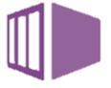

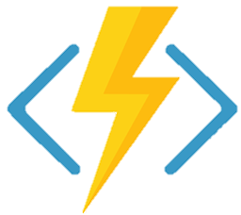
?
?
?
?

Slide 45
Query the building heights data source
For every building
Simple Application
+ Execution Environment
Notes:
With our excellent performance so far, the business has asked us to enrich our data. We want to supply the height of every residential building in a given area.

Slide 46
Developer
Laptop
Application
Version Control
Subscription
AAD – user and permission
Resource Group
WebApp + Application
Table Storage+ Storage Account
2nd Developer+ git, application
Azure DevOps
Environments x2
Environments + 4
Pipelines
Functions
Need to have massive, simple scalability
Application
Function
Add “Function” :”1” to you infrastructure as code.
That infrastructure gets deployed by your pipeline to each environment, so add a function to each of your environments.
Notes:
This is going to require us to query the building heights data source. That's going to be quite a lot of work for every building. We need something that we can delegate that work to. We can write some simple application code. We're going to need an execution environment for it.
A Function would be really good for this. Function apps are super-fast, super-lightweight infrastructure resources. They have limitations - they're limited to 5 minutes of runtime. But because they are super simple, they auto-scale very well. If we supply a couple of bits of work to the function, it'll do those bits of work. If we supply a ton of work, it'll grow to be a ton of instances, and they'll share the load between them.

Slide 47

Developer
Laptop
Application
Version Control
Subscription
AAD – user and permission
Resource Group
WebApp + Application
Table Storage+ Storage Account
2nd Developer+ git, application
Azure DevOps
Environments x2
Environments + 4
Pipelines
Functions
Need to send messages
Storage Account
Queue
Notes:
We'll have to have a way of sending the work to the function. We want to send each building individually to the function, so we want to parcel each building up into a message that the function can pick up when it's ready. The right tool for the job here is Queue Storage.
Queue storage is kind of like a letter box. We can put as many messages as we like into the letter box and, at some point, someone will come and collect them.
Queue storage is a service that is lumped into the Storage Account. We already have a storage account, so let's use the Queue storage part of it. Queue Storage can have multiple Queues (letter boxes), so we'll have one letter box for sending buildings, and another letter box for sending back heighted buildings.

Slide 48


So now we have a system that gives heights of residential buildings
Storage Account
Application
Table
Application
?
Building Heights System
Queue
Queue
WebApp

Slide 49
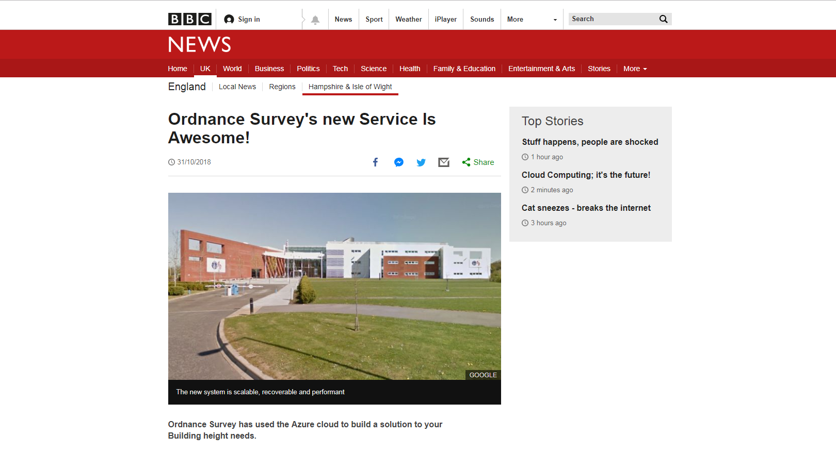
Notes:
It's going so well and our service is being widely recognised. We've even been mentioned on the BBC

Slide 50
Our site is being hammered!
We need more capacity!
Panic!!!!!
“WebApp size: B3”
“WebApp size: S1”
Infrastructure
Change the WebApp size on your infrastructure as code.
Attach a bigger WebApp instance to the back of the WebApps in each environment
Contrast to now…..
Self-Provisioning
Notes:
Our service is getting hammered! We'll need to scale our WebApp.
Happily, it's really easy to give our WebApp more computing power. We'll change the config in our code, and push. This will flow through our environments, and quickly be available in Prod. Contrast that to trying to move things on our on-prem data centre, which would have required HEAT tickets, Ops involvement, pulling people off other work.

Slide 51
They want even more
As a
Local Authority
I want
a list of heighted Residential Buildings in an area
the population density of Residential Buildings in an area
So That
I can use that data to make plans
Notes:
Once again, our customers are delighted with our offerings, and we've been asked to enhance our data yet again.
This time, our customers want to know the population density in buildings.

Slide 52
Office for National Statistics
Compressed file
Once a quarter
Somewhere to load
Something to unpack
(application and execution environment)
Somewhere to store
Notes:
This is a bit different. We don't have that data. The ONS has agreed to supply the data to us. It'll be a compressed file that they'll supply once a quarter, and we'll have to unpack it.

Slide 53

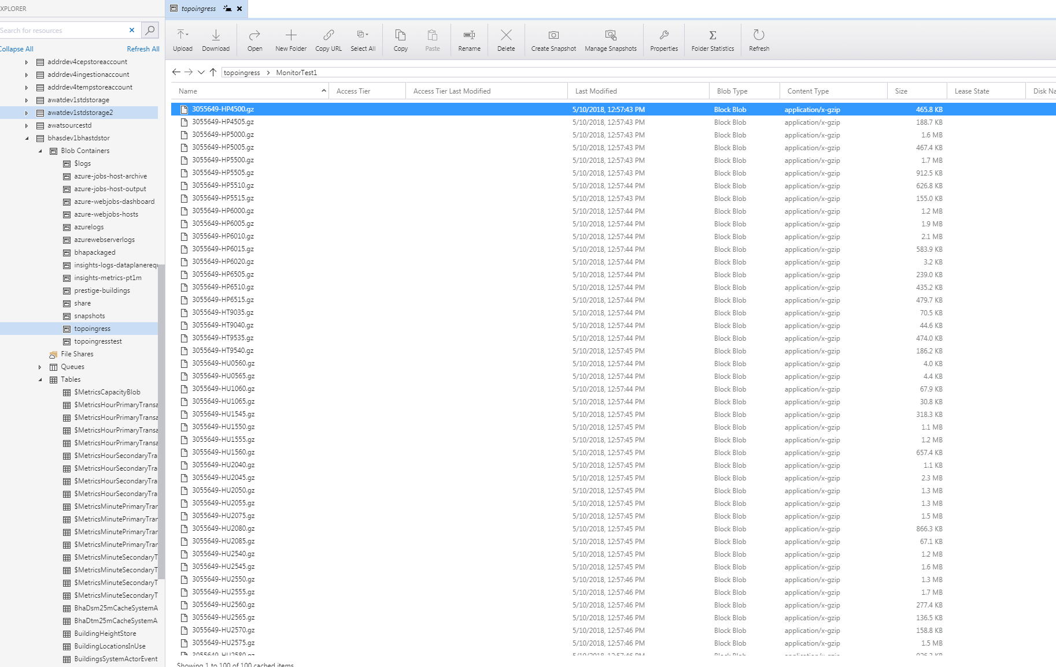
Need somewhere to load
Blob
Blob Storage
Notes:
The ONS is going to load data for us. We need to give them somewhere to put it. We need some storage that will accept big files, and not really care about what they are.
Let's use Blob Storage.
Blob Storage is another Storage Account offering, which takes large files and stores them.
Just like you can share links to files in OneDrive or Sharepoint, you can share links to files held in Blob containers, or to the container itself if you want people to be able to write to it.
This is an entirely different responsibility. It's going to be an entirely different system.

Slide 54
Need to unpack data
Application
Application
Execution Environment
Notes:
We can write some code to run in a function or a webapp that will decompress that file, and put it into table storage.

Slide 55

Need to notice the file load
Event Grid
Notes:
But we need a way of knowing when the ONS have uploaded a file. Event Grids are good for this. Event Grids notice status changes in Azure, and will send those events to whoever is listening out for them. We'll introduce an Event Grid, and use it to trigger the processor whenever a new file is updated. The processor will unpack the data, get it into the shape we want it, and put it into Table storage.

Slide 56
Need somewhere to store
Table
Blob
Storage account
Notes:
We'll also put a WebApi for other services to request data from.
We can update our functions to query for population data of buildings, and we can derive population density metrics from that.

Slide 57
Done!
But…..
It’s too slow…
Notes:
But really quickly after doing that, we find that the performance of table storage isn't up to the input and query demands of the ONS population data.

Slide 58
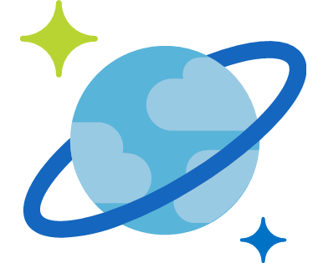
Need more performance from storage
Table
Blob
Cosmos DB
Storage account
Notes:
No matter. We'll bring in Table Storage's more expensive big brother, Cosmos DB. Cosmos looks really really similar to Table Storage, but it performs better.
Good engineering in our systems means it's very easy to switch our code over.
Because we keep this WebApi the same, our functions don't notice that the underlying infrastructure for the data store has changed.

Slide 59
Breaking News!!!!! Again! OS’ new service is even more awesome!
Our site is being hammered!
We need more capacity!
Panic!!!!!
“WebApp size: B3”
“#Instances: 3”
“#Instances: 1”
Infrastructure
Contrast to now…..
Notes:
It's going great, and the customer demand for our population density data is huge. So much so that we can't scale the WebApp up any more. What we can do, like the functions, is scale out the WebApp by adding more instances.

Slide 60
Done!
What have we missed?
Notes:
So, that's our system in Azure.
I just want to cover a few things I’ve intentionally not mentioned.

Slide 61
Storage things
Things that hold data

Slide 62

Storage Account
// stg1ad4g7
Table
Queue
Blob
File
File storage

Slide 63
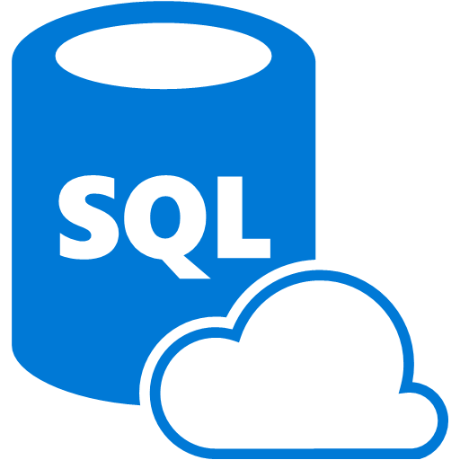
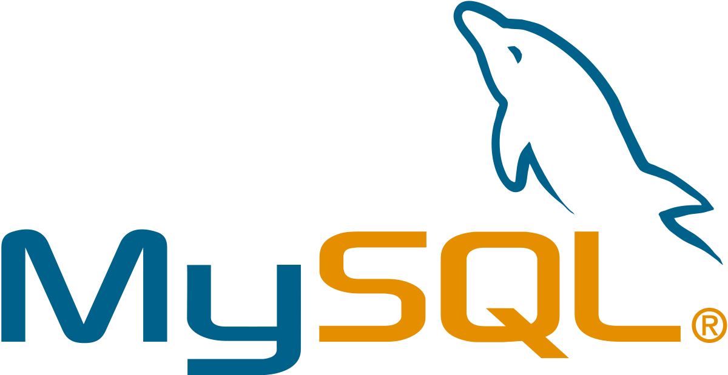
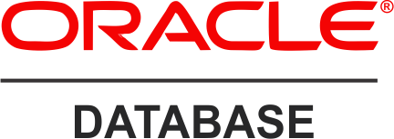
Azure SQL

Slide 64
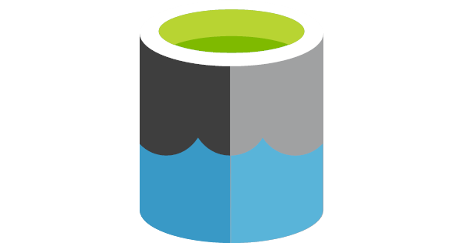
Data Lake

Slide 65
Execution Environments
Application
Things that run code

Slide 66


Virtual Machines

Slide 67
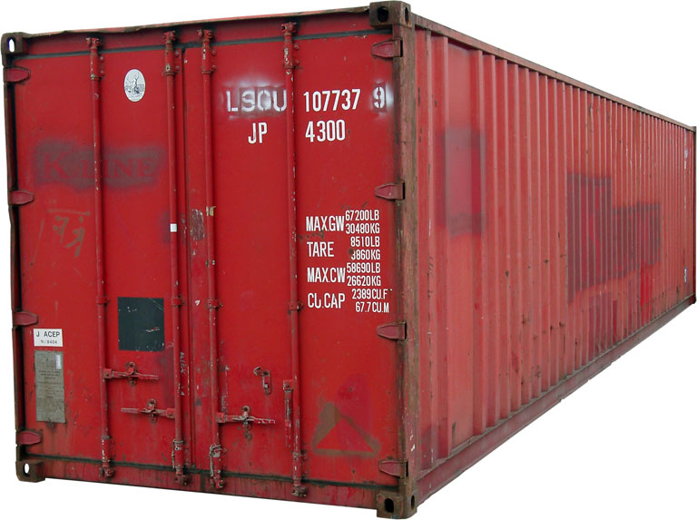
Containers

Slide 68
Messaging things
Things that pass messages

Slide 69

Service Bus
Queue Storage’s big brother

Slide 70

Event Hub

Slide 71
What’s my takeaway?
What is and isn’t Azure
What is my tech lead going on about with subscriptions and queues?
What’s the impact on me?

Slide 72

Your developers need you!
Time and space
Learn the new
Fear
Temptation to fall back to the traditional mindset
Particularly with project pressures
Application
Infrastructure
DevOps, infrastructure, support
are not job roles for individuals in your teams
they are team responsibilities, culture and practices.
Insist on it
Notes:
So what does this mean?
Working in the cloud has just removed the distinction between what was infrastructure and what was application. They are all now just code!
There are many new concepts for Development teams to learn, and a multitude of new options available.
The temptation is to fall back to the traditional mindset of developers write code and IT manage infrastructure.
Common engineering is about changing that culture so we’re here to support development teams learn how to become cross-functional teams capable of developing and operating their cloud applications.
Teams will need your help to create the project and team environments where space is made for learning and teams don’t just create single points of failure.
DevOps, infrastructure, support are not job roles for individuals in your teams they are team responsibilities, culture and practices.

Slide 73
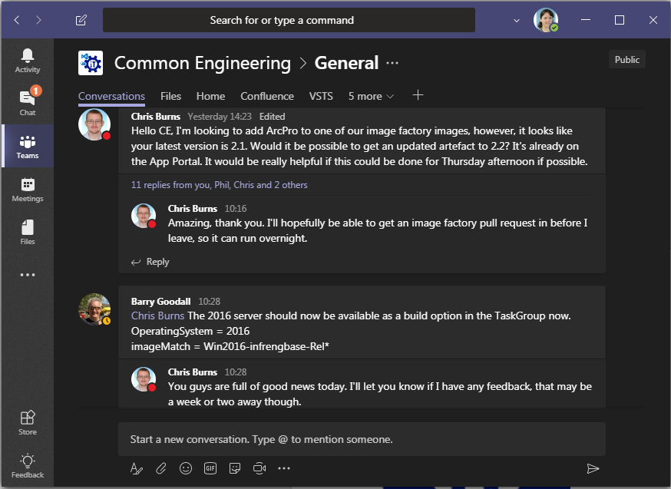

Common Engineering
Notes:
Common engineering is about changing that culture so we’re here to support development teams learn how to become cross-functional teams capable of developing and operating their cloud applications.
We’re doing a ton of consultancy with Development teams, and we’re super active on Microsoft Teams, which is slowly replacing skype. Find us there

Slide 75
The end : ) What questions do you have?
Feedback
It’s running again!
Teresa Binks
Stephen Brown
Tom Prutz

Slide 77
Users
Groups
Group Name:
Users:
Group Name:
Users:

Slide 78
Azure
Active
Directory

Slide 79
… has the role of…
… on the resource called…
… has the role of…
… on the resource called…
Azure Resource Manager
The ARM
… has the role of…
… on the resource called…

Slide 80
Subscription
WebApp Instances
WebApp Size
Storage Account
KeyVault
WebApp Instances
WebApp Size
Storage Account
KeyVault
WebApp Instances
WebApp Size
Storage Account
KeyVault

Slide 81
Deploy to:
Deploy to:
Deploy to:
Deploy to:
System:
System:
Environment:
Environment:
Environment:
Environment:
Environment:

Slide 82
WebApp
WebApp
WebApp
WebApp
WebApp
Azure DevOps
Git
Git
Git

Slide 83
Compile
Test
Package
BHA Application
Infrastructure
BHA
Deploy to:
Building Height Attributes
Azure DevOps
(Team Project)

Slide 84
Building Height Attribute Service
?
?
?
?
Resource Group

Slide 85
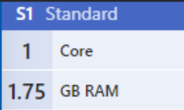
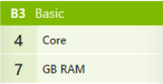

Slide 86
Function
Function

Slide 87
Function
Function

Slide 88
Key Vault
Key Vault
Key Vault
Key Vault

Slide 91
Infrastructure
Infrastructure
Infrastructure
Application
Application
Application
Application
Application
Application
Application

Slide 92
Application
Application
Application
Application
Compile
Test
Package

Slide 93
Storage Account
// stg1ad4g7
// stg1ad4g7
Table
Queue
Blob
File

Slide 94
Storage Account
// stg222afc
// stg222afc
Table
Queue
Blob
File

Slide 95
Storage Account
// stg3bafc
// stg3bafc
Table
Queue
Blob
File

Slide 96
Storage Account
// stg4ff432
// stg4ff432
Table
Queue
Blob
File

Slide 97
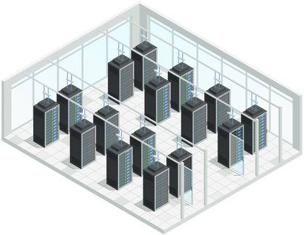

Slide 98
Resource Group

Slide 99

Event Hub
Container
Data Lake
Event Grid
Service Bus
Azure SQL
Cosmos DB

